Slide 1
RESTAURANTS’ INFORMATION DATABASE SYSTEM PRESENTED BY KAZI SAJEED MEHRAB (STUDENT ID – 1505025) RAGIB HASSAN TONOY (STUDENT ID - 1505024

Slide 2
THIS PRESENTATION IS ON THE ENTITY RELATIONSHIP DIAGRAM OF THE PROJECT “RESTAURANTS’ INFORMATION DATABASE SYSTEM”. THE PROJECT IS BEING ADVISED BY MUHAMMAD ALI NAYEEM SIR.

Slide 3
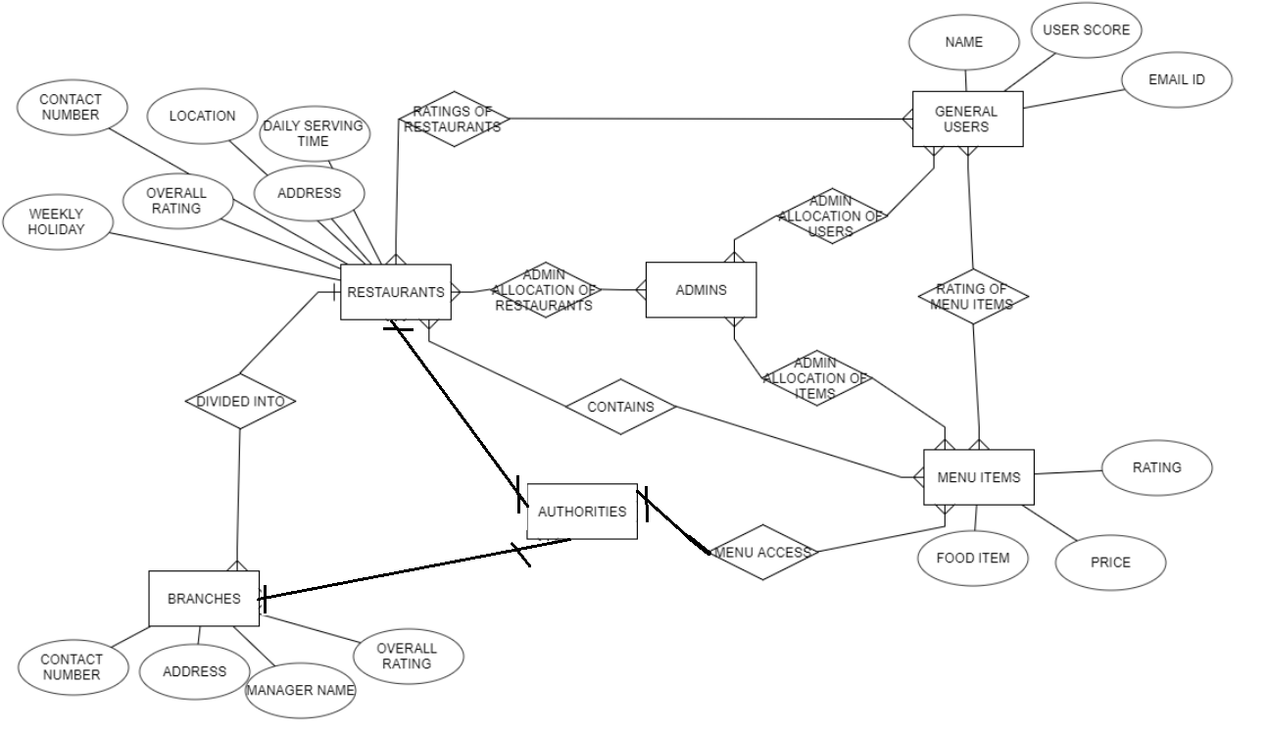
ENTITY RELATIONSHIP DIAGRAM

Slide 4
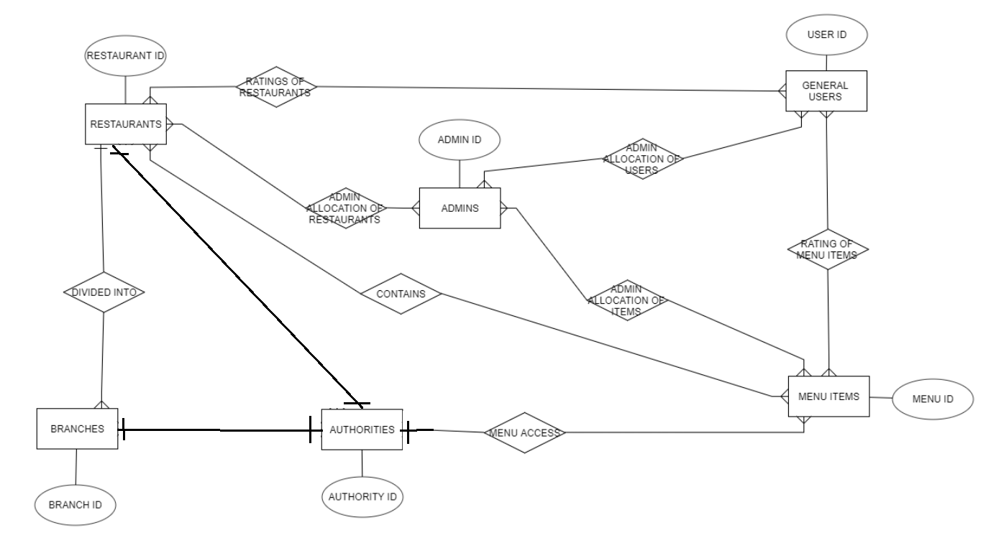
ERD SHOWING PRIMARY KEYS

Slide 5
RELATIONAL SCHEMA
Ratings of Restaurants ((Restaurant ID, User ID) , quality of food, hygiene of food, ambience of the restaurant , behavior of the workers, overall rating)
Admin Allocation of Restaurants ((Admin ID, Restaurant ID) , Approval Status)
Admin Allocation of Users ((Admin ID, User ID))
Admin Allocation of Items ((Admin ID, Menu ID) , Admin recommendation)
Rating of Menu Items ((User ID, Menu ID) , quality of food, hygiene of food, overall rating)

Slide 6
RELATIONAL SCHEMA
Contains((Restaurant ID, Menu ID), Restaurant Name, Menu Name, Location)
Restaurants ((Restaurant ID), Address, Location, Overall Rating, Daily Serving Time, Weekly Holiday, Contact Number)
Branches ((Branch ID), Restaurant Name, Address, Overall Rating, Contact Number, Manager Name)
Menu Items ((Menu ID) , Restaurant Name, Food Item, Price, Rating)
Admins ((Admin ID), Admin Name, Job Title, Restaurant Specialty, Food Specialty, email ID, Password*)
Authorities ((Authority ID) , Admin Name, Job Title, Restaurant Name, Contact Number, email ID, Password*)
General Users ((User ID) , User Name, User Score, User email ID, Password*)

